Slide 1
PRINCIPLES OF ECONOMICS
Salimah Musharrif
FPEC 101 – LECTURE 2 Unit 1

Slide 2
The Market system & Circular Flow

Slide 3
Outline
Fundamental questions
Planned Economic System
Free Market System
Mixed Economic System
Circular Flow of Income

Slide 4
The Fundamental Questions
An economy is an area in which people make or produce goods and services. It may be of any size. The major problem in all the economies is what, how and for whom to produce in order to allocate scarce resources.
What goods and services will be produced?
How will the goods and services be produced?
Who will get the goods and services?
How will the system accommodate change?
How will the system promote progress?

Slide 5
Economic systems- Command
Under this type of economy, the government decides the fundamental questions.
Ownership and control of economic resources is by the government.
Government provides jobs, houses, transport and all other necessities to the people.
There is no private ownership
Profit is redistributed in the economy

Slide 6
Economic systems- Command
Features
Public ownership of all resources
Public wealth is greater than private wealth
There is a high degree of government control
There is equal distribution of wealth
There is a large bureaucracy, that is, planning committees etc
There’s a lack of consumer goods and luxuries as the focus is on
the provision of public and merit goods
There is greater economic stability as the government controls
and so there are no shortages and surpluses, booms and slumps etc

Slide 7
Economic systems- Command
Advantages
Equitable distribution of wealth and equality for all
Full employment
Proper utilization of resources
Diseconomies or external costs are lower as the government takes care
not to pollute etc even if profit is low
Consumers are protected from monopolies

Slide 8
Economic systems- Command
Disadvantages
Sooner or later trade must take place
A large bureaucracy means more corruption
There is no profit incentive
The system is unfair as even if a person has the ability to get a higher income,
he is unable to do so
Lesser variety of products
Lesser individual freedom
The government may misallocate resources as it may miscalculate
the amounts of products needed to be produced
The opportunity cost of planners is high, meaning that the time which the
bureaucracy spends in planning may be used by them to produce something

Slide 9
Economic systems-Market /Capitalistic/Laissez faire
A market economy depends on producers and consumers to make decisions about what, how and for whom to produce. There is no thought of a free economy in the world in its truest sense, but U.S.A comes the closest to it.
Ownership and control of the economic resources
All resources are privately owned by the people and the firms. Products that are in demand are produced. People own private property, business, cars etc
Features
Private Property
Freedom of enterprise and choice, job, business, spending etc
Competition
Very limited role of government
Reliance on price system – Invisible hand

Slide 10
Economic systems-Market /Capitalistic
Advantages
Freedom of choice
Lesser corruption as no one has absolute power
Profit motive ensures efficient production
Competition results in greater variety of products and specialization
Competition also keeps prices in check
Flexible to changes
There is no need for a large bureaucracy

Slide 11
Economic systems-Market /Capitalistic
Disadvantages
Provision of public or social goods will be neglected and emphasis will be on luxuries
May lead to greater unemployment as skilled laborers will be mostly employed
Class differences are greater
Greater chance of monopolies and so consumer exploitation
Price instability due to constant changes in demand
Misallocation of resources as some resources needed for production of necessities may be used to produce luxuries
Small firms may not be able to survive competition

Slide 12
Economic systems- Mixed
The mixed economic system combines government planning with the use of free market. Hence, the allocation and ownership of resources is in the hands of both the public and the private sector.
Ownership and control of the economic resources
In the mixed economy people and firms can earn resources and property in their name. Similarly, along with this, the government also owns certain resources to produces those goods and services which will not be provided by the private sector, but are necessary for the people. It is an Open economy with some control applied by the government

Slide 13
Economic systems- Mixed
Features
Comparatively less unemployment
Public goods are provided easily
Consumer choice exists while the government protects against too many fluctuations
Ban on demerit goods
Environmental responsibilities are undertaken
Government encourages competition to prevent monopolies

Slide 14
Economic systems- Mixed
Advantages
Basic Necessities are provided for all
Ban on demerit goods
Competition keeps prices in check
Profit acts as a motivator and so resources are efficiently utilized
Rights of the consumers and workers are protected
Benefits of international trade can be gained, for example greater production, exports, imports and varieties of goods
The government can earn revenue from taxes
There is lesser unemployment of resources as both sectors are involved
The government will ensure that the private sector take into account the costs they cause to society by imposing certain laws
Redistribution of income is done by taxing the rich and providing services or money to the poor

Slide 15
Economic systems- Mixed
Disadvantages
The government needs to tax people and firms, which may sometimes be high and discourage them from working
Mixed economy systems tend to encourage more state monopolies, higher and higher tax to GDP ratio and dominant public finances, making the Govt. the overwhelmingly large economic player as compared to corporate or individual entities.
Mixed economy system has a natural tendency to move further and further away from reliance on competitive market mechanism to greater and greater bureaucratic controls and interventions. This encourages corruption of the bureaucrats
Since welfare of society is important in a mixed economy it leads to lower than optimum use of the resources because government mobilize the resources towards the production of those goods and services which are beneficial for the society as a whole rather than producing those goods and services which in economic terms are more beneficial for an economy.
Under mixed economy private enterprises have to face lot of difficulty because of various government loopholes like favoritism and bureaucratic nature which is prevalent in mixed economy.

Slide 16
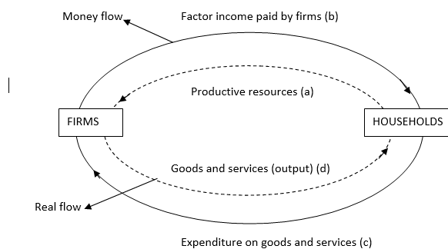
The Circular Flow Of Income

Slide 17
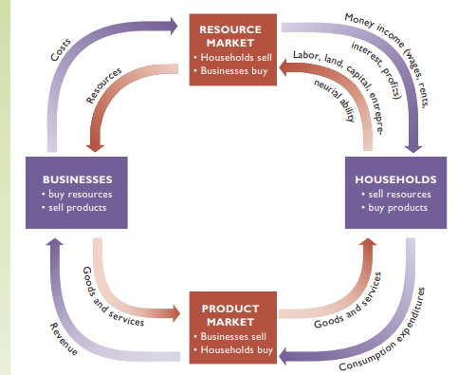
The Circular Flow Of Income
Fig 2.2, Page 39
Economics by Mc. Connell & Brue 17th edition

Slide 18
The Circular Flow Of Income
Resource Market
Resources or the services of resource suppliers are bought and sold.
Households own all economic resources either directly pr indirectly
Workers, entrepreneurs directly, through ownership of business corporations indirectly.
Businesses pay for these resources as costs to businesses but flows of income in the form of wage, rent, interest, and profit income to the households.
Productive resources flow from households to businesses, and money flows from businesses to households.

Slide 19
The Circular Flow Of Income
Product Market
Place where goods and services produced by businesses are bought and sold.
Businesses combine resources to produce and sell these goods and services.
Households use the income earned to purchase goods and services.
The monetary flow of consumer spending on goods and services yields sales revenues for businesses.

Slide 20
Summary
Fundamental questions
Planned Economic System
Free Market System
Mixed Economic System
Circular Flow of Income

